Slide 1
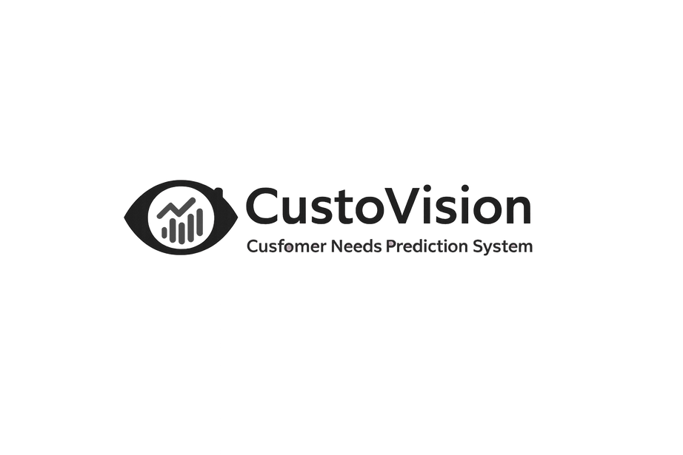



CUSTOVISION
Name: IREMBERE Olivier
ID:28392
University: Adventist University of Central Africa (AUCA)
COURSE :Database Development with PL/SQL )
NAME OF PROJECT:
PRESENTED BY:
CUSTOVISION
IREMBERE Olivier

Slide 2


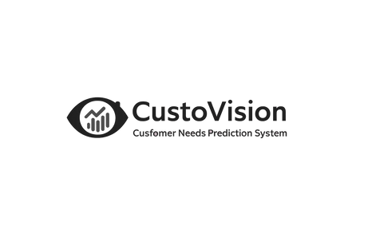
02/10
Many businesses struggle with:
Stockouts & over-purchasing
Unpredictable customer demand
Lack of data-driven insights for inventory and marketing
Target Users: Managers, inventory planners, marketing teams

Slide 3
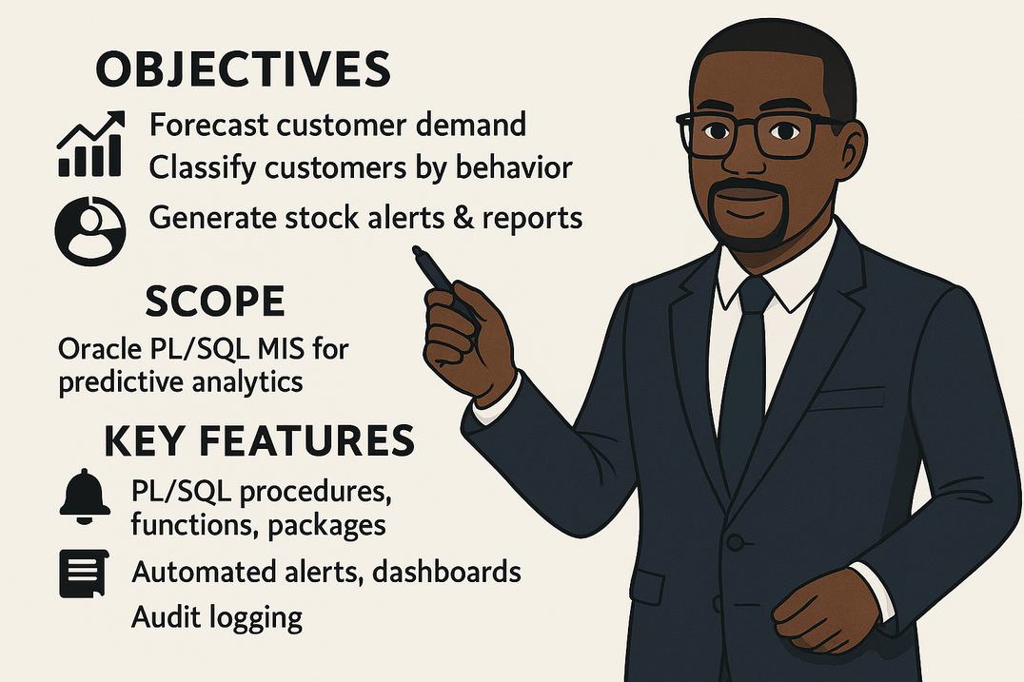
03/10
Project Scope
01
Objectives:
Forecast customer demand
Classify customers by behavior
Generate stock alerts & reports
02
Scope: Oracle PL/SQL MIS for predictive analytics
03
Key Features:
PL/SQL procedures, functions, packages
Automated alerts, dashboards, audit logging

Slide 4

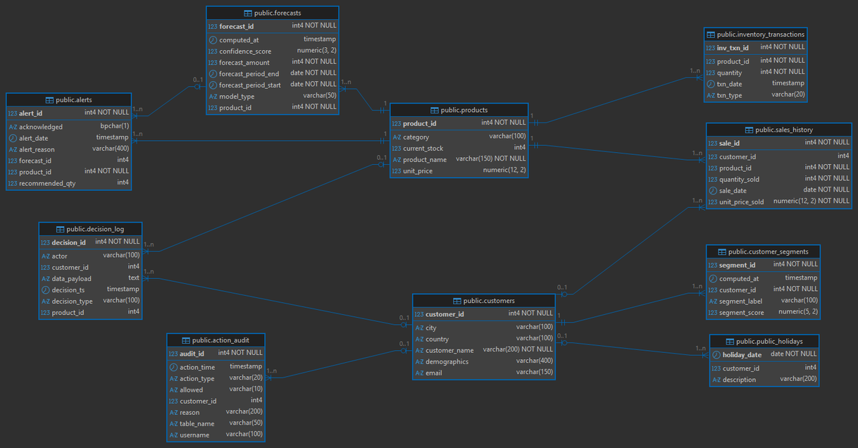
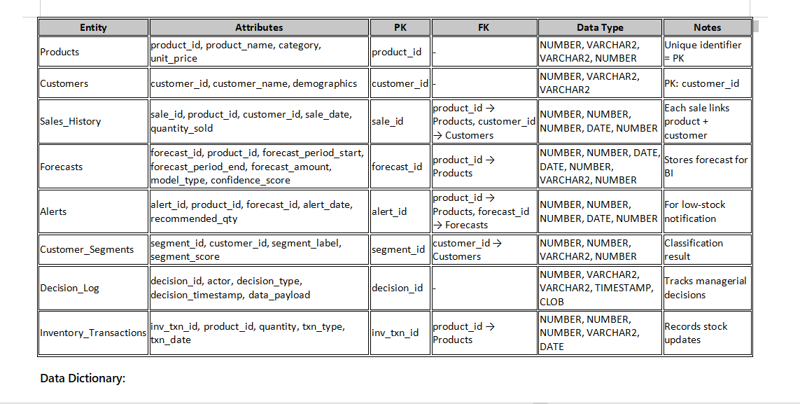
04/10
Database Design
Entities: Products, Customers, Sales_History, Forecasts, Alerts, Customer_Segments
Relationships: PK/FK connections, cardinalities enforced
Normalization: 3NF, minimal redundancy

Slide 5
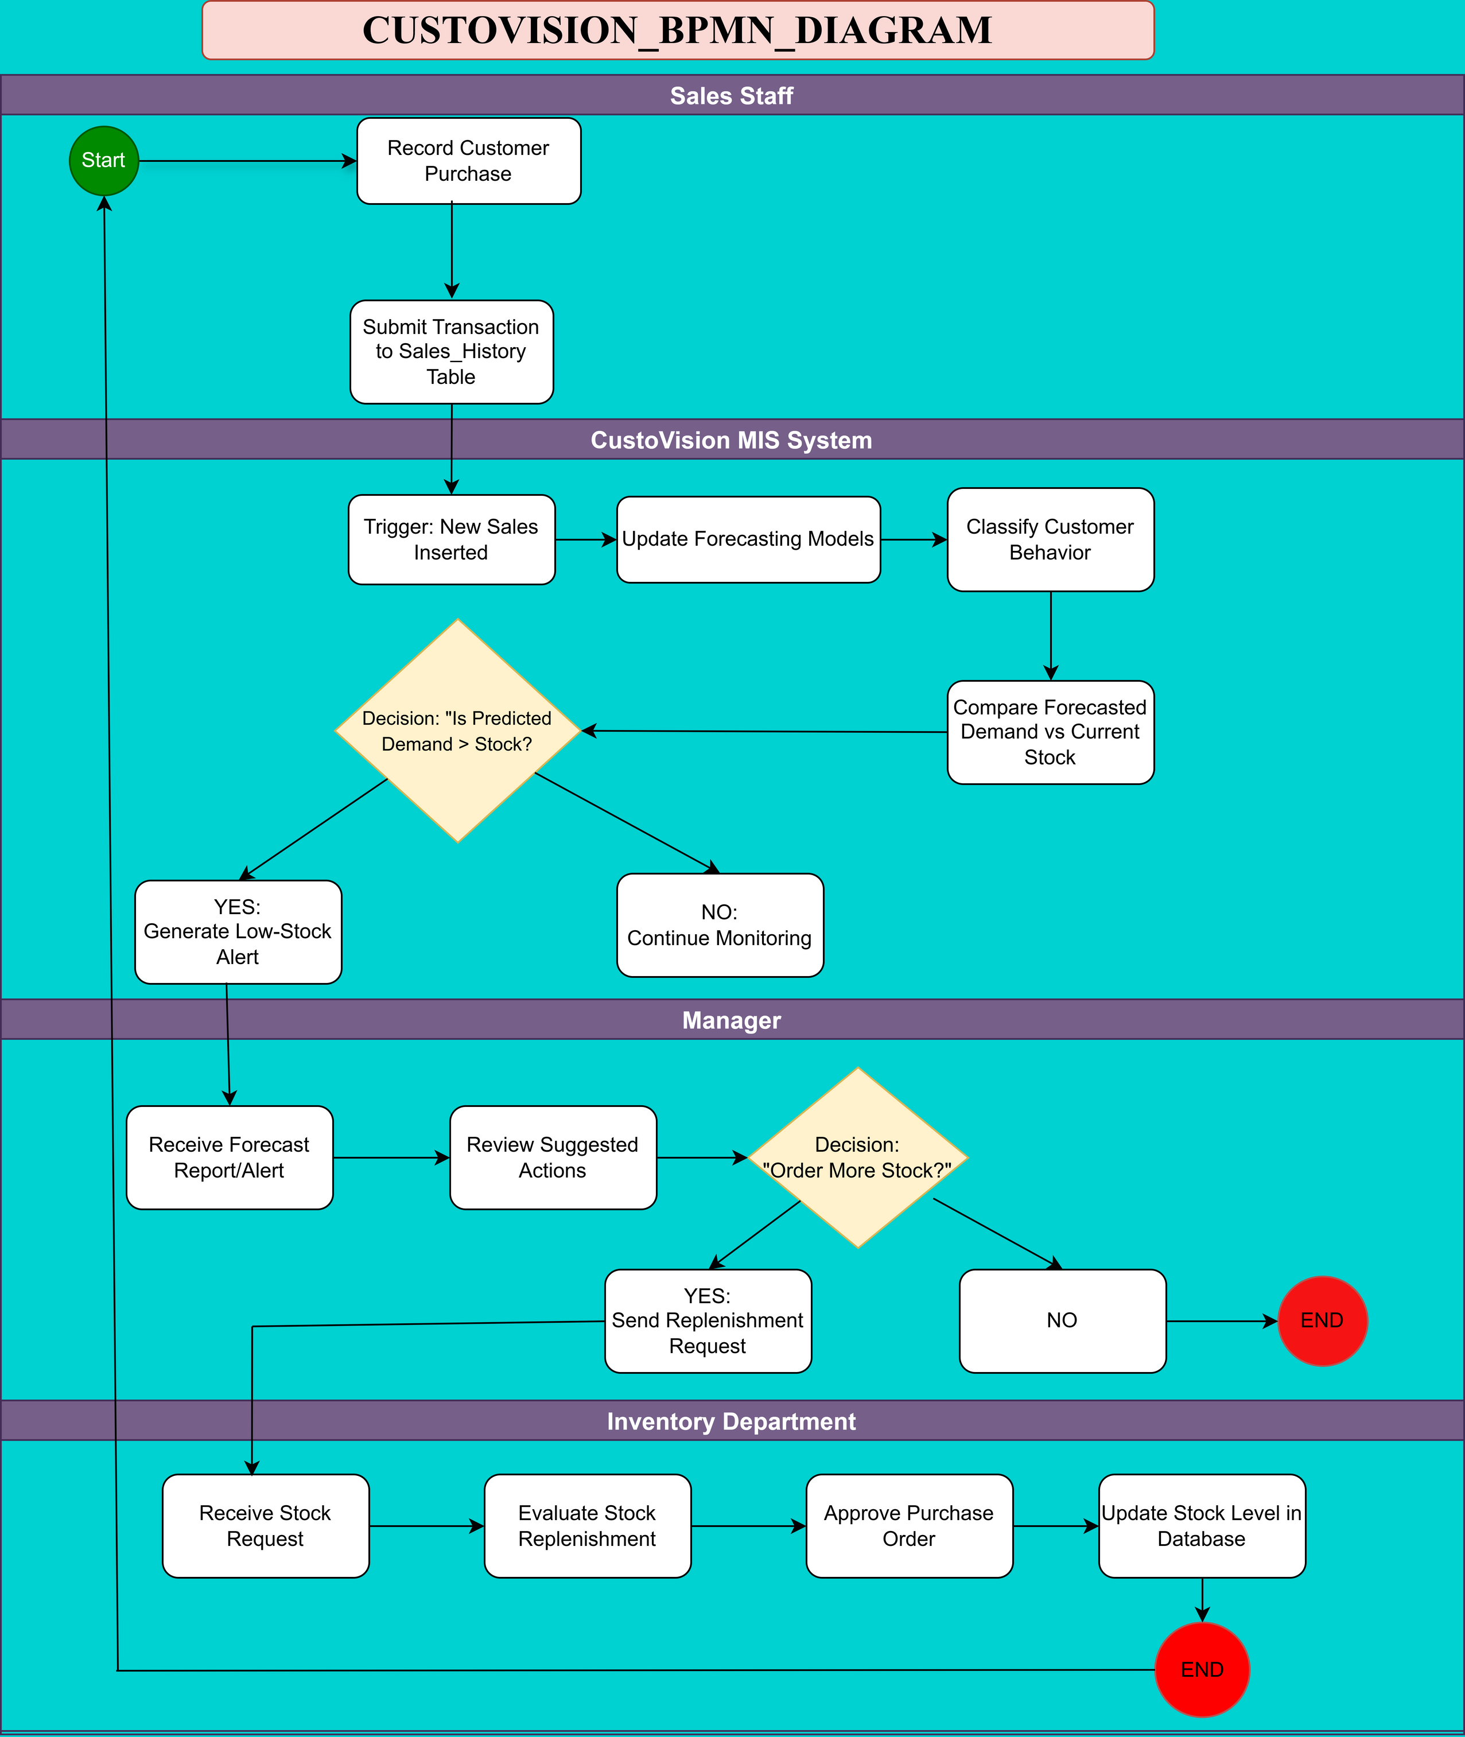

05/10
Business Process
Workflow: Customer purchase → Data capture → Forecast → Alerts → Manager decisions
Actors/Swimlanes: Sales Staff, MIS Engine, Inventory Dept, Manager
MIS Relevance: Supports inventory planning, marketing, and decision-making

Slide 6
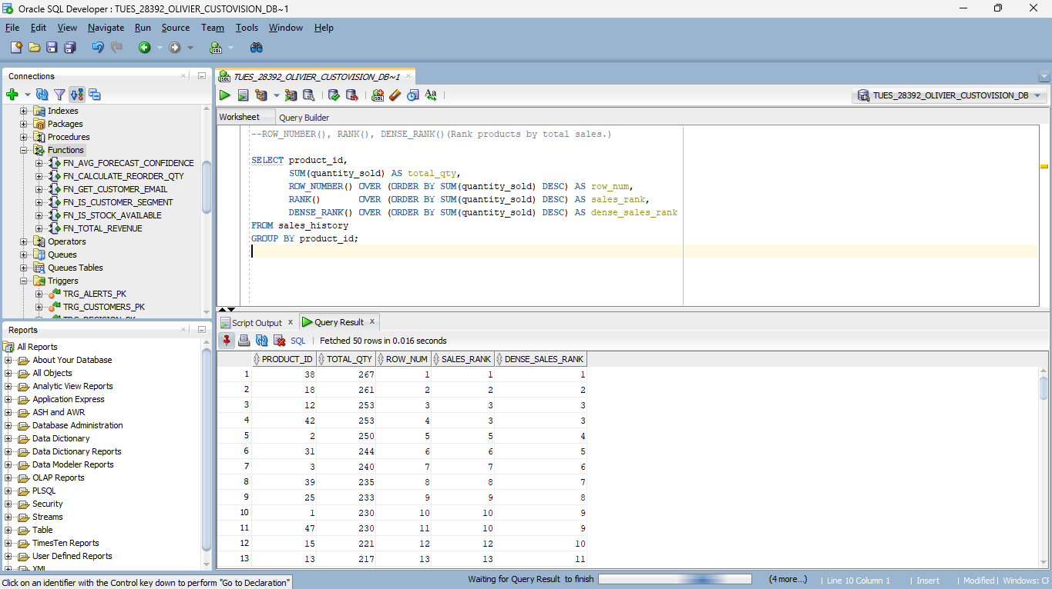
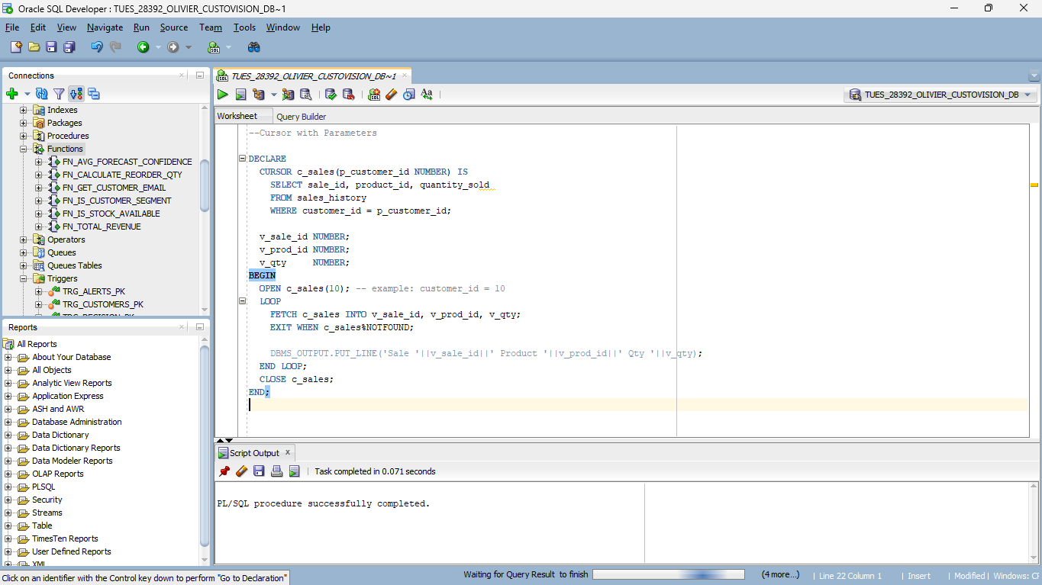
06/10
Technical Implementation
Technology: Oracle 19c, PL/SQL, SQL Developer
Procedures & Functions: Parameterized, DML operations, exception handling
Cursors: Explicit + bulk processing
Window Functions: ROW_NUMBER(), RANK(), LAG(), LEAD()

Slide 7
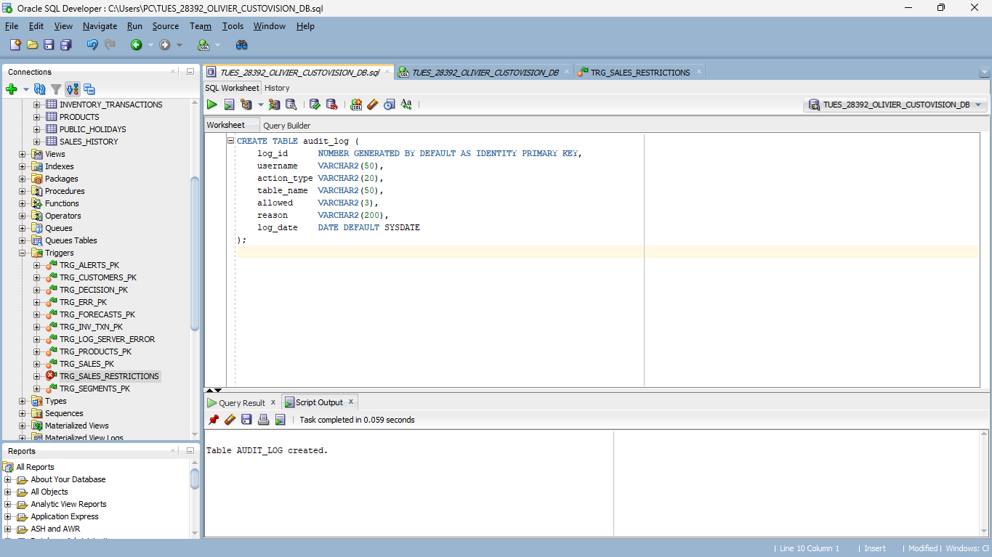
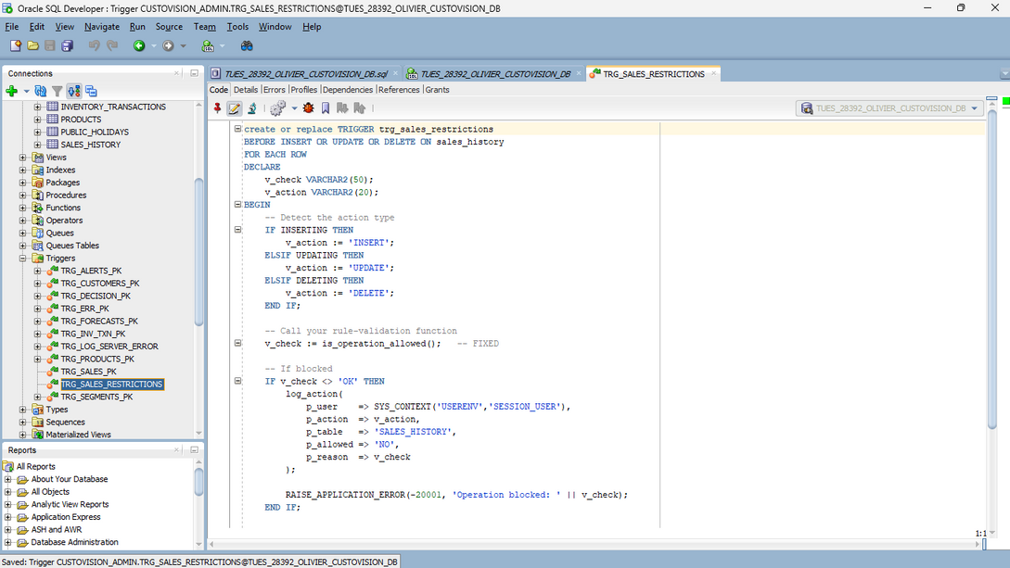
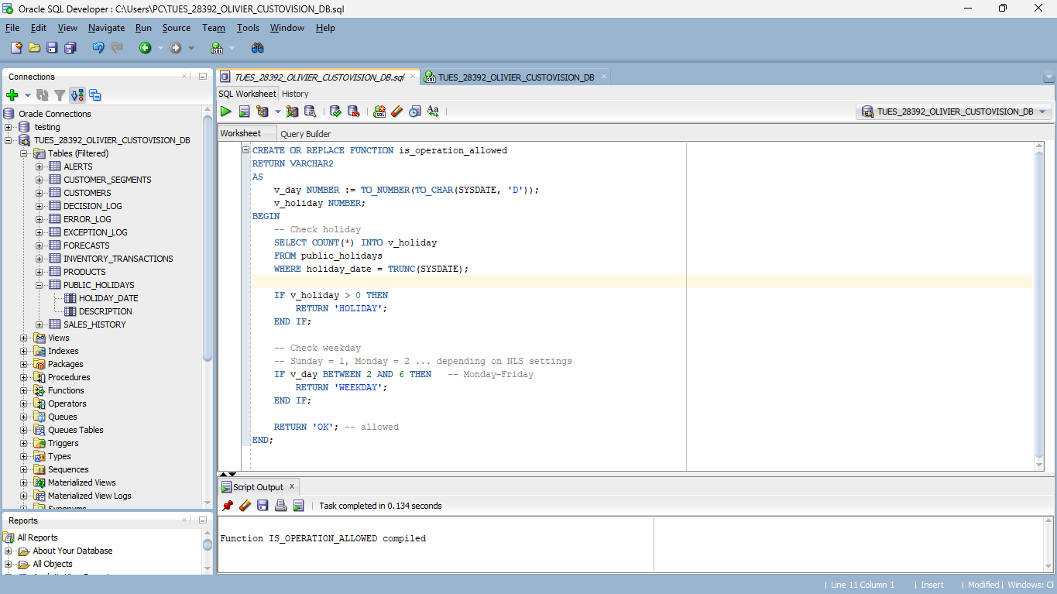
07/10
Advanced Features
Triggers & Business Rules:
Block operations on weekdays and public holidays
Audit Logging:
Tracks all insert/update/delete attempts
Stores user info, timestamps, error messages
Security & Restrictions: Ensures compliance and accountability

Slide 8
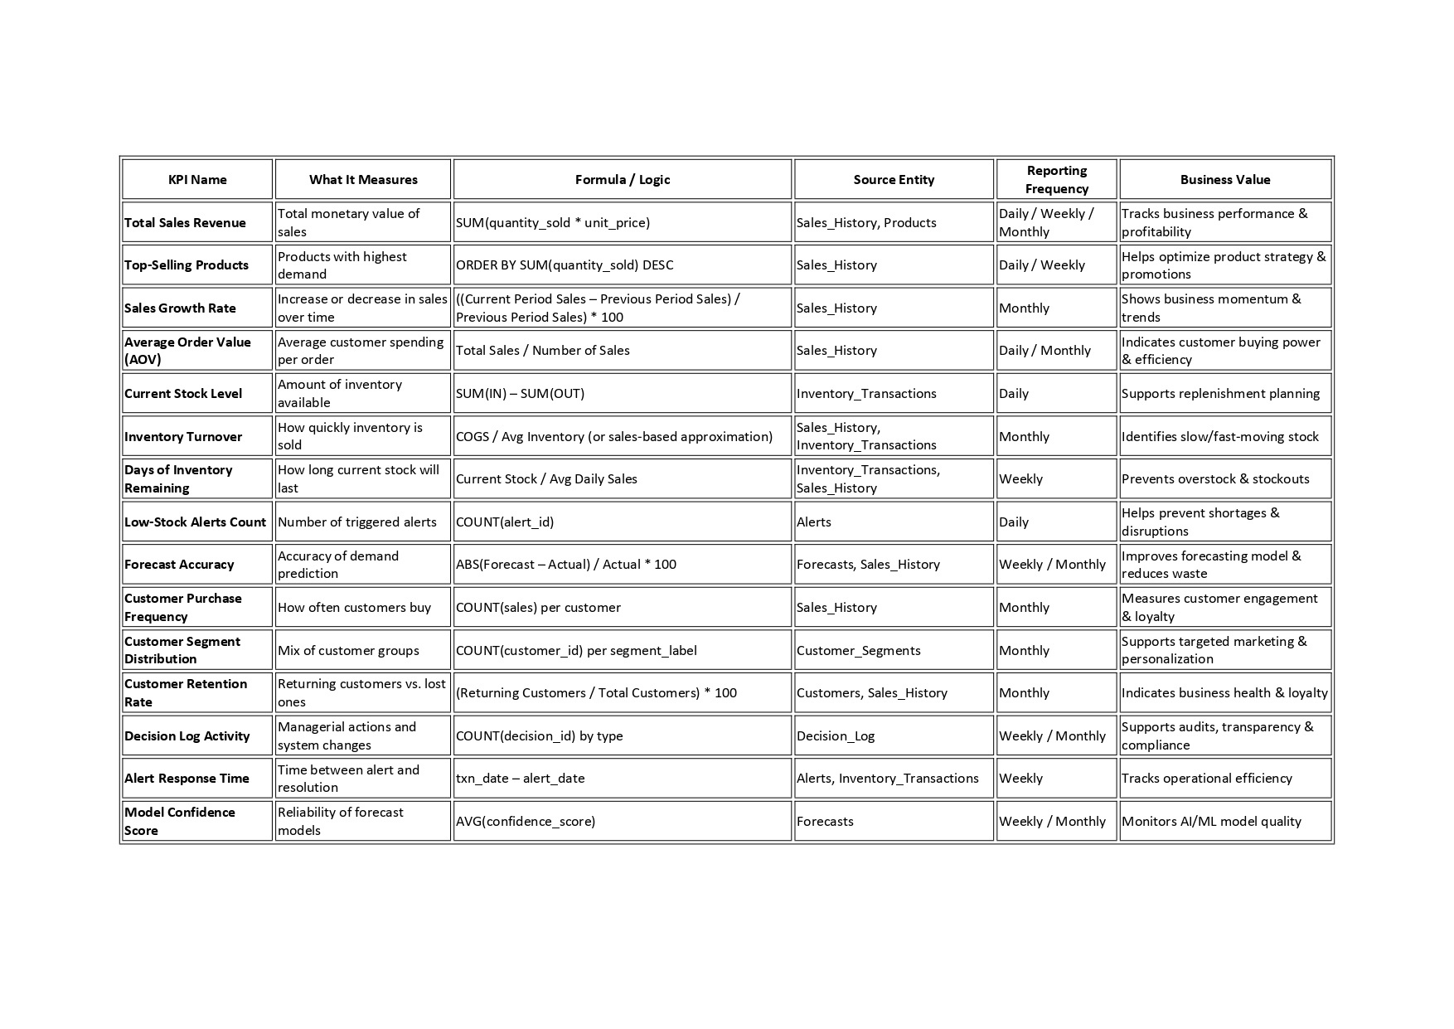
08/10
BI & Analytics
KPIs: Sales performance, inventory health, customer behavior, compliance metrics
Dashboards:
Executive Summary
Audit Dashboard
Performance Dashboard
Reports & Decision Support: Daily, weekly, monthly

Slide 9
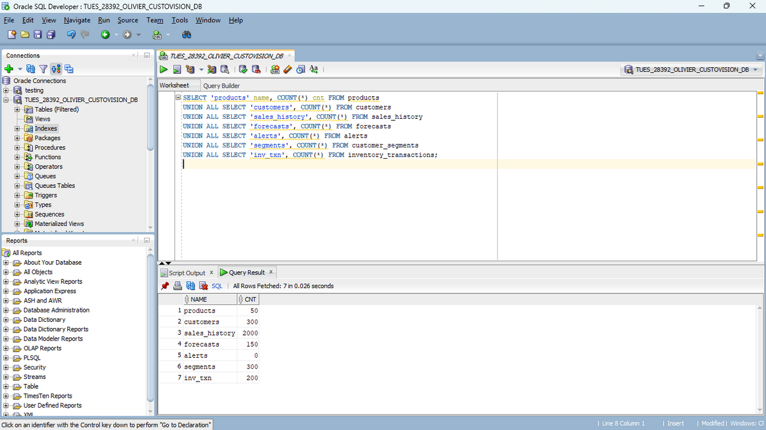
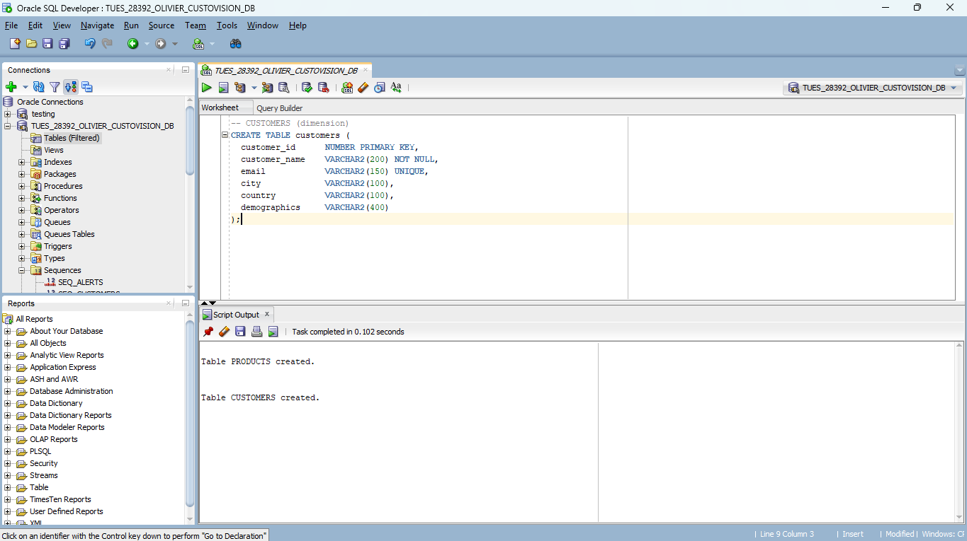
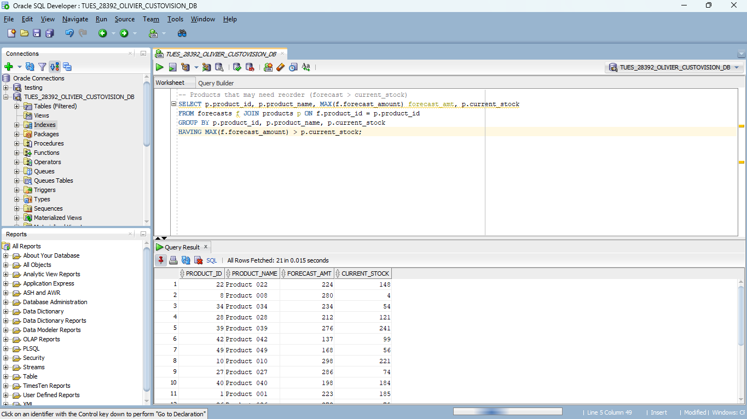
09/10
Results & Testing
Data Volume: 100–500+ rows per main table
Validation: DML constraints, foreign key enforcement, edge cases tested
Performance: Queries optimized, procedures and functions validated
Screenshots: Test queries, alert generation, audit logs

Slide 10
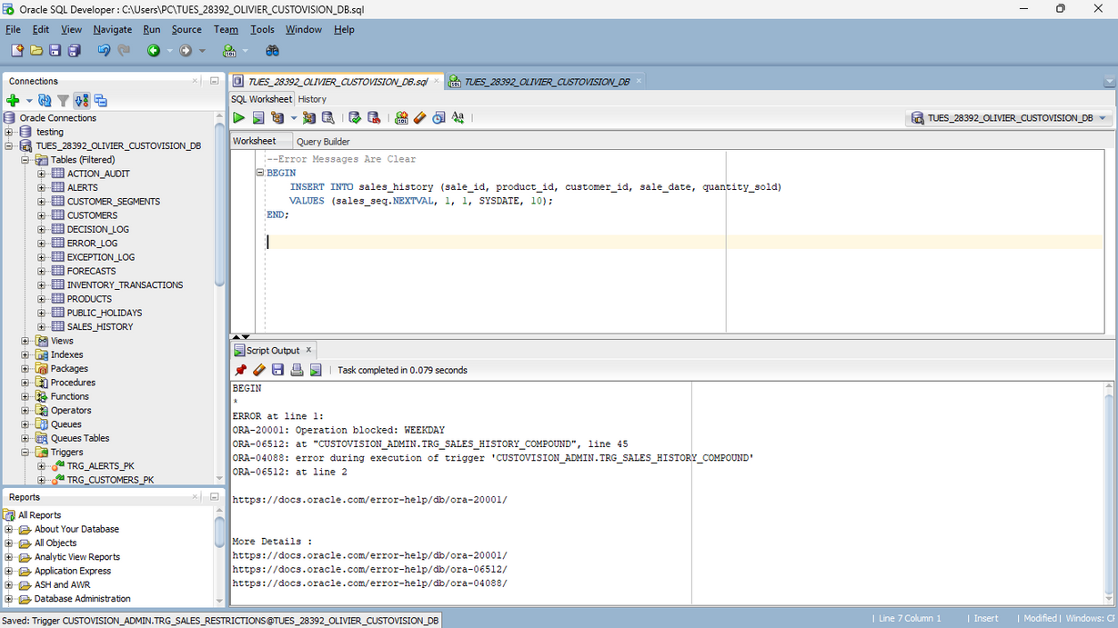
10/10
Conclusion
Achievements:
Fully functional MIS with predictive analytics
Automated alerts, auditing, and dashboards
Reliable, normalized database structure
CONTACT US
E-mail
olivierdylanelan@gmail.com
Phone
+250786699988
github
https://github.com/IREMBERE/Customer-Needs-Prediction-System-Custovision-
THANK YOU‼️

